Slide 1
Binary Search Trees
Modified version of https://www.cs.unc.edu/~plaisted/comp550/15-btrees.ppt
Questions added from GATE

Slide 2
For large amounts of input, the linear access time of linked lists is prohibitive – weiss
Forms of trees(balanced BST, 2-3 trees) provide an average running time of O(log n) for most operations.
Comp 122, Spring 2004

Slide 3
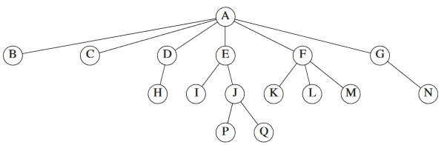
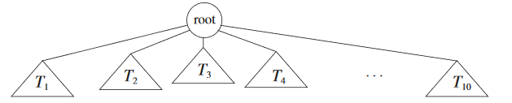
Root node: A
Child of D: H
Parent of D: A
Each node has
a subtree under it.
Comp 122, Spring 2004

Slide 4
Depth: The depth of a node is the number of edges in the unique path from the root to the node. Root depth=0
*Depth of a tree is equal to the depth of the deepest leaf.
Height: The height of a node is the length of the longest path from node to a leaf. All leaves are at height 0.
*The height of a tree is equal to the height of the root.
Depth of a tree is equal to the height of the tree.
Ancestor-Descendant: If there is a path from n1 to n 2,then n1 is an ancestor of n2 and n2 is a descendant of n1. If n1 = n2,then n1 is a proper ancestor of n2 and n2 is a proper descendant of n1

Slide 5
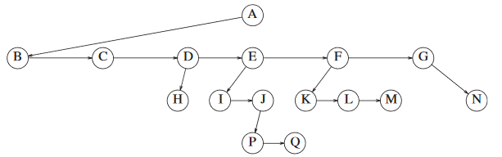
Implementation
When number of children is not known
Struct TreeNode
{ char * string;
TreeNode *firstChild;
TreeNode *nextSibling;
}
Node:
value: data
left: pointer to left child
right: pointer to right child
Comp 122, Spring 2004

Slide 6
Binary Trees
Recursive definition
  An empty tree is a binary tree
  A node can have not more than two children.
binary tree
56
26
200
18
28
190
213
12
24
27
Comp 122, Spring 2004

Slide 7
Binary Tree Implementation
When number of children is atmost two.
Struct TreeNode
{ char * string;
TreeNode *firstChild;
TreeNode *secondChild;
}
Comp 122, Spring 2004

Slide 8
Max depth of a binary tree of n nodes ?
Traversals
Inorder : Left Root Right
Preorder : Root Left Right
Postorder: Left Right Root
Comp 122, Spring 2004

Slide 9
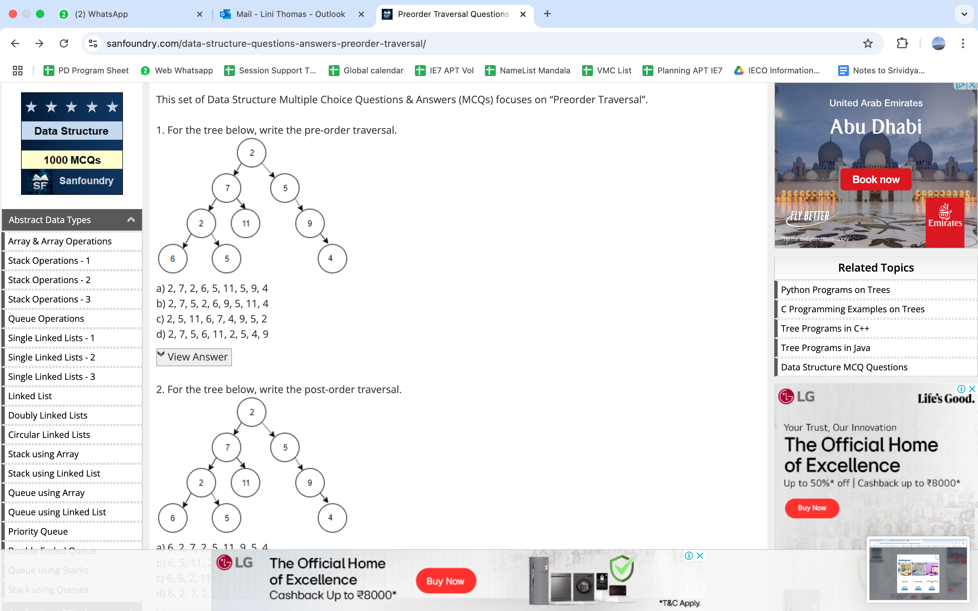
Write out the inorder, post order and pre order traversal of the above figure
Assume the digits 7, 5, 1, 8, 3, 6, 0, 9, 4, 2 are added in that sequence into a binary search tree that is initially empty. The binary search tree follows the standard natural number ordering. What is the resulting tree's inorder traversal sequence?
Consider the following data. The pre order traversal of a binary tree is A, B, E, C, D. The in order traversal of the same binary tree is B, E, A, D, C. The level order sequence for the binary tree is _________

Slide 10
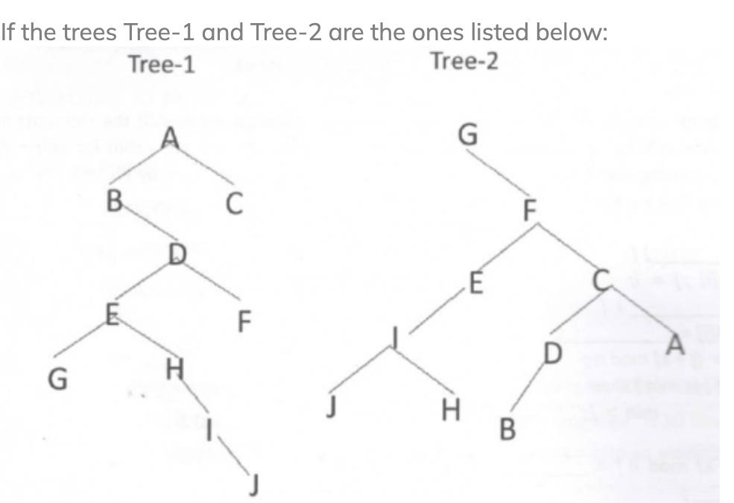
Which ordering of each tree
gives the same sequence
The in-order traversal of a tree resulted in FBGADCE.
Then the pre-order traversal of that tree would result in
FGBDECA
ABFGCDE
BFGCDEA
AFGBDEC

Slide 11
Inorder : Left Root Right
Preorder : Root Left Right
Postorder: Left Right Root
For a binary tree T, let the preorder traversal be [ 1, 2, 7, 3, 4, 5, 6 ] and inorder traversal be [2, 7, 1, 4, 3, 6, 5]. Can you construct the tree T.
Comp 122, Spring 2004

Slide 12
More definitions
A full binary tree (sometimes proper binary tree or 2-tree) is a tree in which every node other than the leaves has two children.
For a FULL binary tree T, let the preorder traversal be [ 1, 2, 3, 4, 5, 6, 7] and postorder traversal be [ 2, 4, 6, 7, 5, 3, 1 ] . Construct the full binary tree T.
Comp 122, Spring 2004

